Slide 1
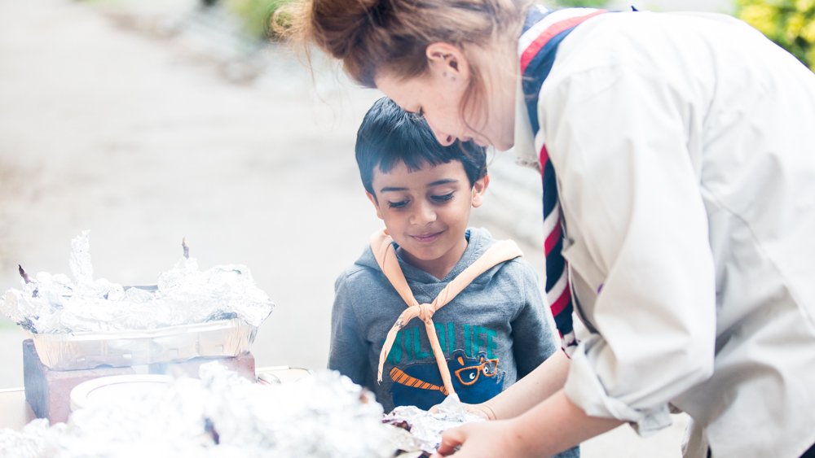
Module C: That’s the way to do it!
Module J: Communicate it!

Slide 2
Webinar – what you need to know
There is a chat function, you can pop any questions you have in the chat at any time and we will try and answer them.
Sometimes you will go into Breakout rooms of smaller groups. There, you are able to talk to each other to share ideas. There will be a leader to help give you ideas but it is up to you to take part!
We may ask you to feedback to the whole group – please use the chat rather than have lots of people talk at once. I’ll read out your comments so the whole group can hear.
We will be providing these slides afterwards so don’t panic about detailed notes of every slide.
Notes:
Briefly cover the etiquette of the webinar

Slide 3
Module C Aims:
Understand and be able to talk about how young people learn effectively including different learning styles.
Know how to pass on skills including different training techniques.
Module J Aims:
Understand the importance of effective communication between young people and leaders in the section.
Know how to adapt communication styles to suit an activity.
Explain how tone and body language affects how you communicate.
Be able to communicate the skills gained from being a young leader to those outside of Scouts.
Notes:
Cover the aims of the webinar.

Slide 4
Ways to teach skills.
Notes:
We’re going to look first as the different ways of teaching skills and when is best to use each different method.

Slide 5
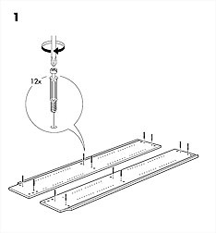
Learning styles
Young people learn in different ways.
Some find these instructions easy to understand while others find them impossible.
Some need words or verbal instructions.
Some need pictures they can copy.
Some need a person or video to show them what to do between the pictures.
Notes:
Explain that the picture, shown from IKEA style instructions, some people find enough to understand where some find them unbearable because they need something more like videos or text.

Slide 6
Teaching styles
Different methods suit different learning styles and different situations.
Which you use depends on the activity, the size of your group, how the group is reacting to you and resources available to you.
They both need to learn it and not become too bored.
All have advantages and disadvantages.

Slide 7
Try to draw this picture. Listen carefully.
Notes:
Read the instructions below. This helps to understand the weaknesses of verbal methods. Some need more time, some are in a hurry to carry on. You need to understand the technical language in the instructions.
Draw a short horizontal line in the middle of your page. From the left end of this line draw a near vertical line of similar length upwards slanting slightly to the left. At the top of this new vertical line draw a filled in circle. Return to your first horizontal line. Above this, draw a parallel horizontal line slightly shorter than the first that joins up to the vertical line. From near where this new line meets the vertical line, draw three quarters of a circle around to the left. Return to the first line and from the right edge draw a diagonal line down and to the right. End this line with a perpendicular diagonal line to the right.

Slide 8
Teaching styles
Talking
Pros
Useful for rules of a game.
Effective when instructions are short and easy to understand.
Gets a message across to a lot of people at once.
Cons
Gets boring if too long.
Can be confusing if jargon or technical language is used.
Pace is a problem – too slow for some and too fast for others.
Notes:
Using what we’ve learned what pros and cons are there to talking like that?

Slide 9
Teaching styles
Try thinking of the advantages and disadvantages for each of these:
Diagram or picture
Demonstration
PowerPoint presentation
Written
Group instruction
To break out rooms.
Notes:
Explain the task and send off to break out rooms.

Slide 10
Teaching styles
Diagram or picture
Pros
Useful when everyone needs to make the same thing.
Everyone gets the same message.
Helps young people know if they’re doing it right (looks like the picture) or not.
Cons
Getting enough copies for everyone can be a challenge.
Often skip steps or may be unclear how to get from one picture to another.
Can be unhelpful on their own.
Notes:
Get the Yls to think about the pros and cons of each method. Their opinions can be gathered through the use of the chat or breakout rooms.

Slide 11
Teaching styles
Demonstration
Pros
Effective and has impact.
When combined with the young people trying it themselves, is often effective.
Works well in small groups.
Can be very hands on.
Cons
Harder in bigger groups, both to see or have 1:1 problem solving with a leader.
Not useful if the leaders shows the young people without a chance for them to try it themselves.
Notes:
Get the Yls to think about the pros and cons of each method. Their opinions can be gathered through the use of the chat or breakout rooms.

Slide 12
Teaching styles
Presentation using PowerPoint
Pros
Useful for large groups.
Can get lots of information across or show pictures/video clearly to lots of people.
Effective if they have a clear and simple message.
Helpful for distance learning.
Cons
Can be lengthy or boring if not careful.
Not always equipped for them.
Death by PowerPoint if not careful!
Notes:
Get the Yls to think about the pros and cons of each method. Their opinions can be gathered through the use of the chat or breakout rooms.

Slide 13
Teaching styles
Written material
Pros
Independence when learning new skills.
Can provide detailed instructions that can be read at any time.
Useful for Scouts +
Cons
Think about number of copies needed.
Less suitable for Beavers and Cubs – reading skill not fluent enough.
Difficult to visualise if text on its own.
Notes:
Get the Yls to think about the pros and cons of each method. Their opinions can be gathered through the use of the chat or breakout rooms.

Slide 14
Teaching styles
Group instruction
Pros
Easier to demonstrate and answer questions.
Quicker access to a leader or an experienced/trained peer leader.
Can rotate the activities through the groups.
Cons
All leaders would need to know what is happening or their role in the evening.
Difficult to see the bigger picture.
Notes:
Get the Yls to think about the pros and cons of each method. Their opinions can be gathered through the use of the chat or breakout rooms.

Slide 15
Passing on skills summary
Choose a technique that will work for what you need to do, the age group and what resources you have.
I do, We do, You do works very well when teaching practical skills.
Try to make sure a range of learning styles are catered for.
Visual (pictures or video)
Auditory (Listening or talking)
Kinesthetic (Touching or moving something yourself)
Notes:
Sum up what we’ve learned already.

Slide 16
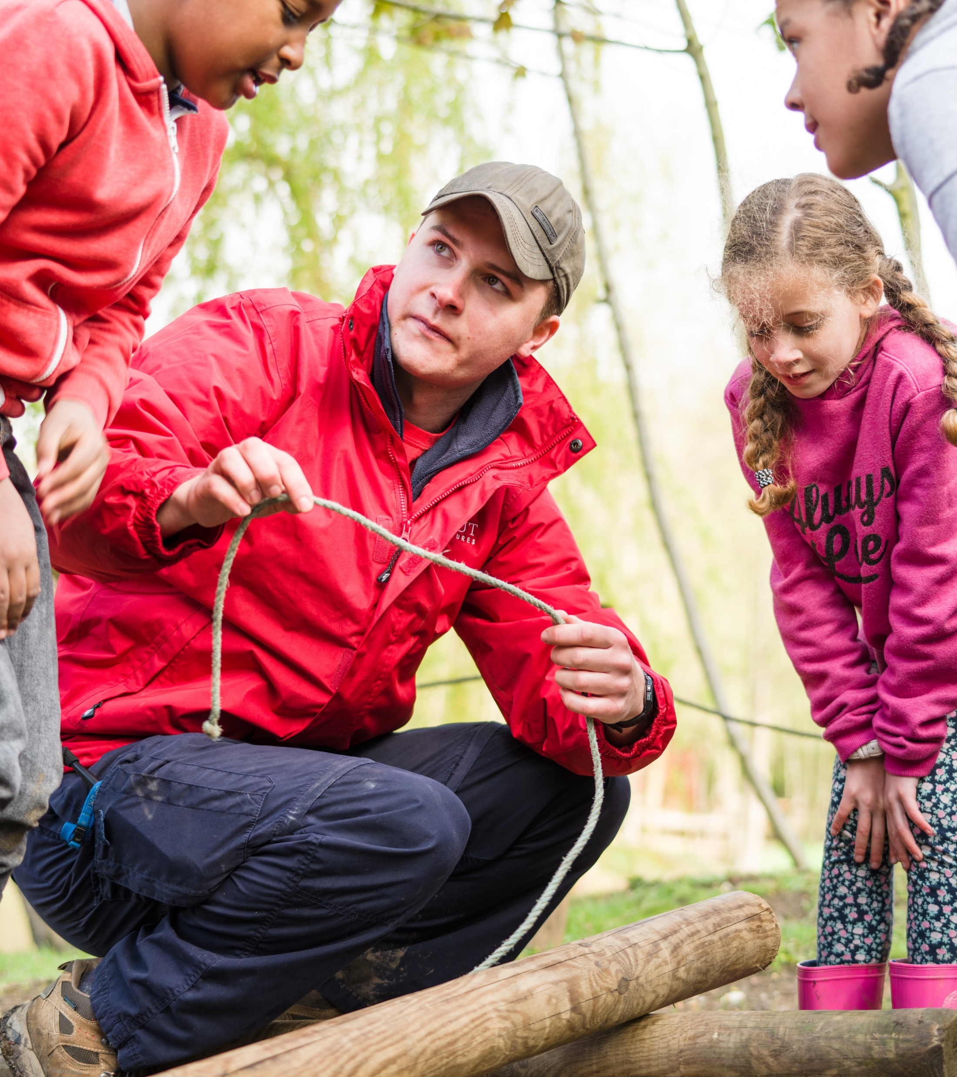
Communication skills.

Slide 17
Different ways of communicating
Think of all the different ways we communicate in Scouts.
Pop them in the chat:

Slide 18
Different ways of communicating
One-One conversations
Meetings
Flyers
Newsletters
Text messages
Facebook
Twitter
What’s App
Snapchat
TikTok
Instagram
Video calling, conferencing – Skype, Zoom
Presentations
Phone calls
E-mails
Letters
Notice boards
Web sites
Notes:
Compare the list they came up with, with this list (taken from Scouts Module 9 – Working with Adults)

Slide 19
Concentration and listening
Listen to the foreword by Bear Grylls. How many times are the following mentioned?
The word Scout/Scouts
Any number
The word stories
Any word starting with an f.
Notes:
Encourage Yls to keep a count in whichever way they want. The aim of this activity is not to keep count but that it is hard to listen when you’re focusing on something else.

Slide 20
Concentration and listening
In the chat, answer these questions about what you just heard:
How many Scouts are there?
What did the first Scouts learn the names of?
He wrote the results in which best selling book?
Who is Bear Grylls – what is his given role?
Notes:
50 million; 2. constellations, animals and plants; 3. Scouting for Boys; 4. UK Chief Scout and Chief Ambassador of World Scouting
Scout/Scouts: 9 (12 with Scouting included); Numbers: three; stories: 2; f: 18

Slide 21
Concentration and listening
Was it hard to listen?
What distracted you?
Could you concentrate on both of those things?
How did you feel when I revealed that the counting didn’t matter?
Notes:
Time to think.

Slide 22
Body language and tone of voice.
Body language and how we say something can change the meaning of what we say.
In break out rooms, practice saying a sentence in different tones of voice to your group. It could be in a kindly, angry, bored or any other way you can think.
If you are able to, you could also act out a scene to the group without making any noise and see if the group can guess based on your body language and expressions.

Slide 23
Communication top tips
Give clear instructions that the audience will understand (language choices, directions, specific needs)
Stop everything when saying something important. Summarise if there is one thing they need to grasp.
Avoid information overload – rule of three, no more than five.
Tone of voice and body language are important. Change it depending on what you are doing and with who.
Open questions – useful for understanding and behaviour.
Notes:
Summarise and offer these extra top tips.

Slide 24
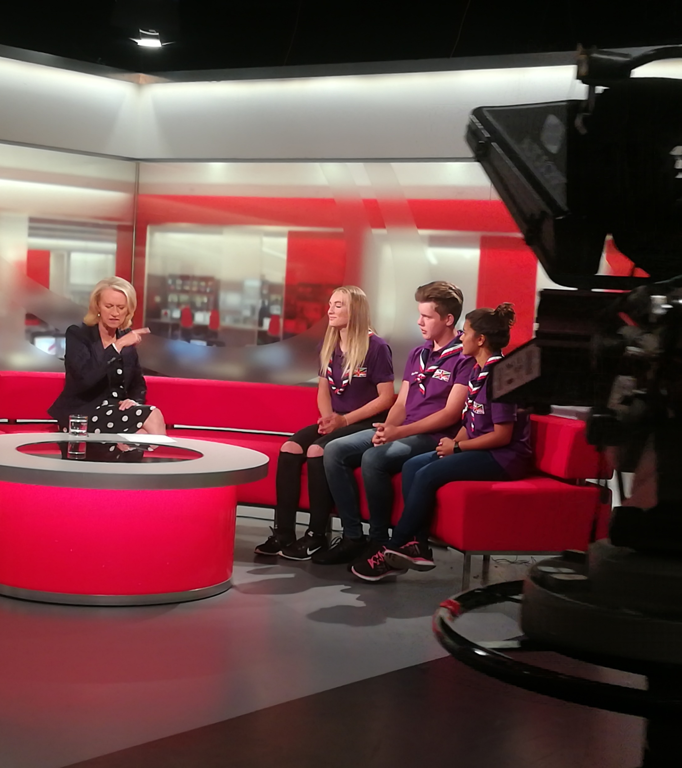
Speaking to others about the Young Leader scheme.

Slide 25
Why do we tailor what we say?
People don’t know what we do.
People guess based on their experience.
We’ve changed and they don’t know or realise.
Notes:
We can’t presume the audience already know about us well. Lots of people have very outdated or inaccurate ideas about us including that we’re still just for boys, or we only camp and tie knots. It is not all we do and we’ve changed a lot.

Slide 26
Talking Top Tips
When talking to the public, keep it conversational and relatable.
We focus on the Skills for Life that Scouts give.
Avoid using jargon and abbreviations/initialisms
Beavers/Cubs/Explorers → Beaver Scouts, Cub Scouts
GSL/DC → Lead volunteer, volunteer manager
ABSL → Adult volunteer, volunteer leader
Notes:
Best practice for talking about Scouts these days is to keep it conversational and relatable when talking to the public and to talk about skills for life.
Examples of this could be talking about encouraging Scouts to ‘think on their feet’ rather than be independent, ‘have a plan B’ rather than advanced planning or ‘giving it a go’ rather than develop motivation. We may not need to do this when talking to employers who use this language.
Also we should avoid abbreviations and jargon that we in the Scouts know but which others don’t – use more general terms instead that are easy to understand. We talk publicly about Cub Scouts rather than Cubs to make it clear they are Scouts, volunteer managers rather than DCs and adult volunteers rather than abbreviated role titles.

Slide 27
Audiences
Who might you talk to about the Young Leaders scheme?
Friends
Parents
Teachers
Interviewer
Social Media
What information and skills would you highlight to each? How are they different?
Break out room time!
Notes:
Who might we need to talk to about this? Ideas in the chat.
What is most important for each audience to know?

Slide 28
Skills for Life
Every activity you do as a young leader uses skills – those you have and those you are learning and practicing.
Imagine you are telling other people about what you do.
What skills could you tell others about?
In breakout rooms, choose an activity from the list and think about what skills you’ll be learning through it. There are some at the bottom of the sheet to give you ideas.

Slide 29
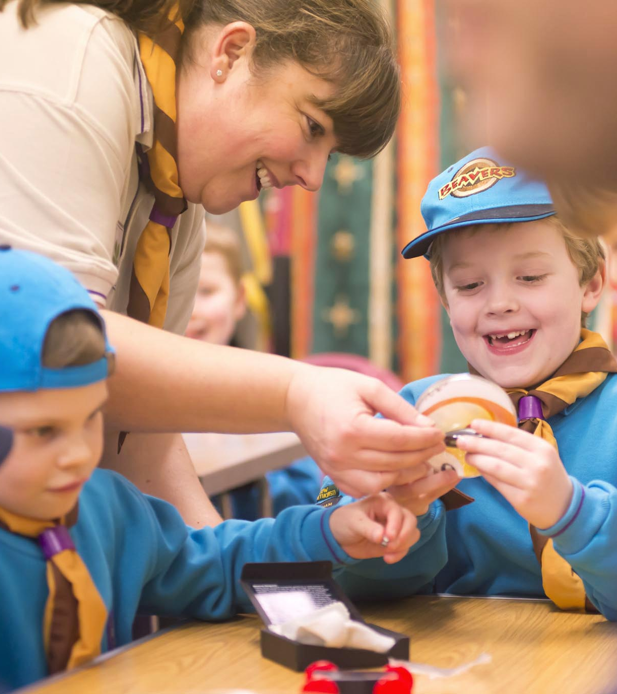
Where next?

Slide 30
Where next?
Use what you’ve learnt – Mission 1 and 2.
More modules coming up.
C (Teaching skills) and J (Communication) – 28th January
D (Behaviour) and F (Inclusion) – 4th February
E (Games) and I (Forums and YouShape) – 11th February
G (Programme) and H (Programme planning) – 25th February
K (First Aid) – 4th March. Extra eLearning required.
A (Essentials and expectations) – 15th March
Adult leader training link (18)
Notes:
Cover where they can go from here, useful for missions. Plug other modules and mention that this links into Module 8 of the adult leader training.

Slide 31
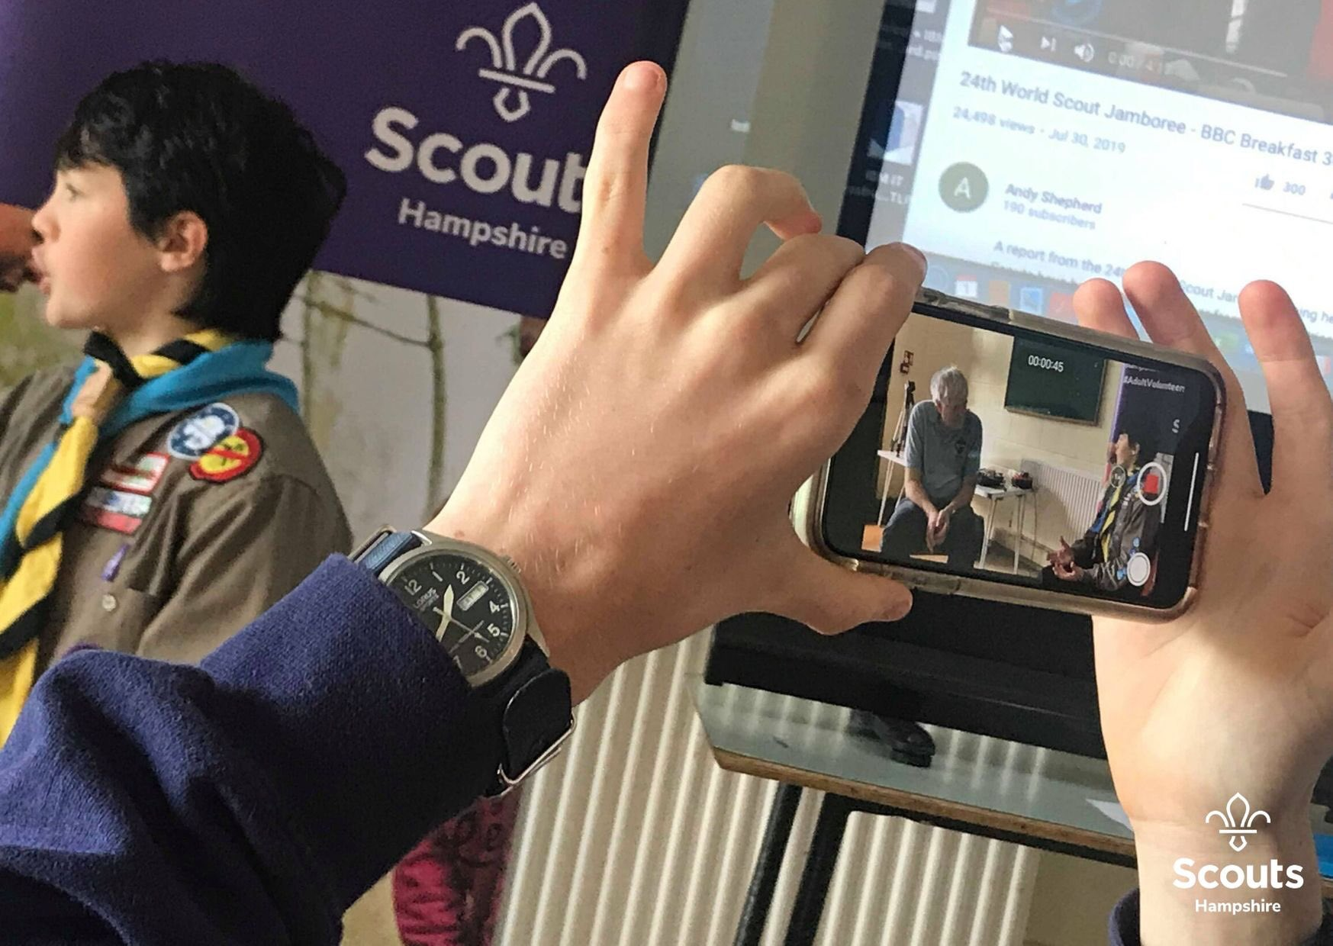
Where next?
Scouts Speak Up courses run by Hampshire Scouts to help you talk to others about Scouts.
Notes:
Cover where they can go from here, useful for missions. Plug other modules and mention that this links into Module 8 of the adult leader training.

Slide 32
Quiz time!
Check what you’ve learned and help us know who was on this call.
Your certificate will be generated by those that complete the quiz.
It will ask you for a word at the end to prove you took part – the word is FUTURE.
Link in the chat.
Notes:
Explain the quiz to complete the module.

Slide 33
Module C: That’s the way to do it!
Module J: Communicate it!

